Slide 1
Nutritional Optimization of Food Ingredients and Indian Wood Herbal Packages for Adolescents for the Prevention of Covid-19 and Its New Variants in Efforts to Increase Immunity and Achievement Using Genetic Algorithms
1/16

Slide 2
Background
Based on data from RISKESDAS RI (2018) adolescents aged 13-15 and 16-18 years experience 3 nutrition problems, stunting, wasting and obesity.
Based on analysis from SATGAS COVID-19 (2021) 1,79% contracted the covid 19, isolated themselves, were declared cured and died..
Diet and smoking patterns can affect heal and susceptibility to autoimmune diseases(Rachmawati dan Pradana, 2020)
Reason for Genetic Algorithms
Genetic Algorithm can perform optimization on complex problems
Genetic algorithm can search large rooms or large amount s of data.
2/16

Slide 3
Formulation of the Problem and Purpose
Problem
Purpose
01
01
02
02
How can genetic algorithm provide an overview of the solution for implementing nutritional optimization in food ingredients?
Applying the genetic algorithm method for nutrition optimization in food ingredients for teenagers.
Knowing the optimal parameter comparison in the genetic algorithm method in optimizing food nutrition for teenagers.
How can parameter value for genetic algorithm to implementing nutritional optimization in food ingredients?
3/16

Slide 4
methodology
Research type
Non-implementative analytics which analyses the surrounding conditions from the results of quantitative data
Research strategy
development of a genetic algorithm in a system that aims to optimize food nutrition for adolescents to increase immunity and achievement in adolescents.
6/16

Slide 5
Langkah Algoritma Genetika
7/16

Slide 6
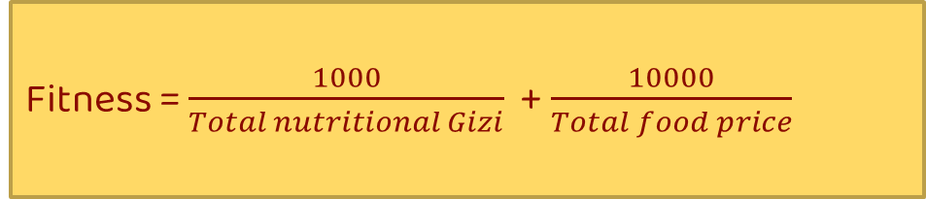
Manualisasi (Fitness dan Elitism)
Fitness = $\frac{1000}{Total nutritional Gizi}$ + $\frac{10000}{Total food price}$
In the search process for the fitness value, the total penalty value and the total price must be obtained which will be processed using the formula
The use of constant values ​​functions to balance each value, which in this case contains the total nutritional penalty and the total food price (Sari, Cholissodin dan Rahayudi, 2021)
8/16

Slide 7
Representasi Kromosom
Breakfast |  |  |  |  |  | Lunch |  |  |  |  |  | Dinner
P | N | H | S | B | He | P | N | H | S | B | He | P | N | H | S | B | He
Keterangan:
P : Staple food
N : Nabati
H : Hewani
S : vegetable
B : Fruit
He : Herbal
En : Energy
Pr : Protein
Le : Lemak
Ka : Karbohidrat
Vi : Vitamin C
Breakfast
Staple Food
En | Pr | Le | Ka | Vi
Chromosome length used from each individual is 18 genes
9/16

Slide 8
Data Used
Examples of raw material data used in calculations
No | Kategori Bahan | Nama Bahan | Energi | Protein | Lemak | Karbohidrat | VitC | Harga /kg | Berat(gr) | Harga/gr
0 | Pokok | Ubi jalar kuning | 114 | 0,80 | 0,50 | 26,70 | 22,00 | 13.000 | 100,00 | 1300
1 | Pokok | Ubi jalar merah | 123 | 1,80 | 0,70 | 27,90 | 22,00 | 12.000 | 100,00 | 1200
2 | Pokok | Bihun | 360 | 4,70 | 0,10 | 82,10 | 0,00 | 9.000 | 100,00 | 900
3 | Pokok | Biskuit | 458 | 6,90 | 14,40 | 75,10 | 0,00 | 23.000 | 100,00 | 2300
4 | Pokok | Macaroni | 363 | 8,70 | 0,40 | 78,70 | 0,00 | 15.500 | 100,00 | 1550
5 | Pokok | Maizena ( pati jagung ) | 343 | 0,30 | 0,00 | 85,00 | 0,00 | 17.500 | 100,00 | 1750
6 | Pokok | Roti Putih | 248 | 8,00 | 1,20 | 50,00 | 0,00 | 20.000 | 100,00 | 2000
7 | Pokok | Mi Kering | 339 | 10,00 | 1,70 | 76,30 | 0,00 | 20.000 | 100,00 | 2000
8 | Pokok | Talas Bogor | 108 | 1,40 | 0,40 | 25,00 | 4,00 | 16.000 | 100,00 | 1600
10/16

Slide 9
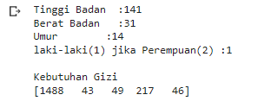
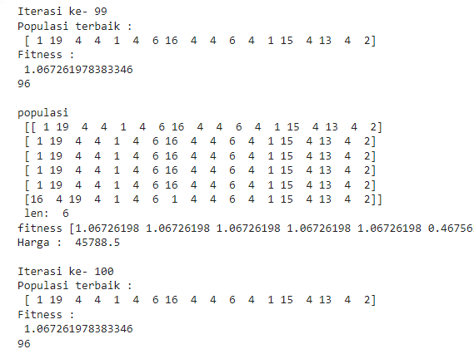
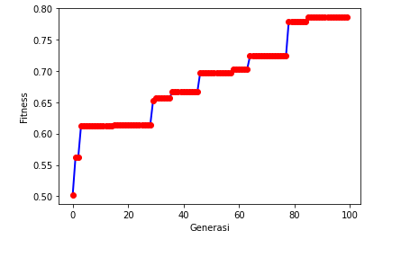

Implementasi
GUI Display and Nutritional Needs Value
Graph of Fitness Value and Generation
Weight Requirement Value
The Best and Last Iteration Stage
11/16

Slide 10
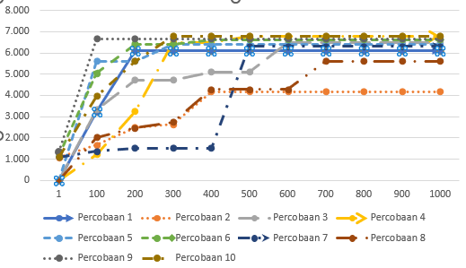
Testing and Discussion
Convergence Testing
The highest generation value is obtained in the 600th generation, which has an average fitness value of 5985.2 and experiences the same value in subsequent generations up to the 1000th generation.
In the convergence test it is known that the 600th generation is the starting point for convergence which is marked by the similarity of values ​​in the next generation, the next test value can use the 600th generation up to the 1000th generation.
12/16

Slide 11
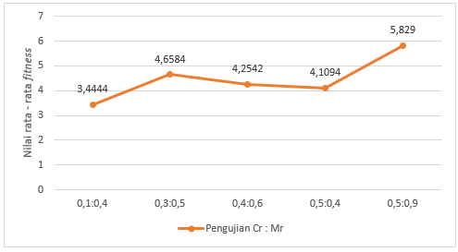
Testing and Discussion (Cont.)
Testing cr : mr
It was found on cr and mr that a large cr: mr value would be directly proportional to the fitness value obtained. The highest cr and mr values ​​are obtained at a comparison of 0.5:0.9, which has an average fitness value of 5.829 and there is a decrease if the comparison value is low.
The cr: mr value will affect the fitness value issued, because the cr and mr values ​​function to determine the number of offspring that will be issued as children.
13/16

Slide 12
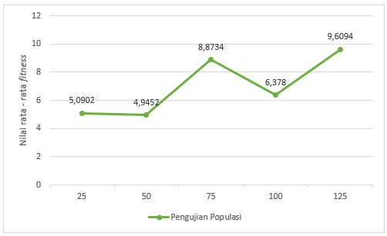
Testing and Discussion (Cont.)
Population Testing
It is found that the addition of the population has a fitness value that tends to increase. The best average fitness value was obtained in population 125, which was 9.6094 with a total of 5 trials, with the lowest fitness value obtained in population 50, which was 4.9452.
Increasing population values ​​can increase the opportunity to get higher fitness values, and vice versa if the population used is small, the fitness values ​​obtained tend to be low.
14/16

Slide 13
Closing
Conclusion
It was found that all patients had presentations below 20%. The different percentage differences were due to random initialization, and also the amount of data that was less than optimal and also limited could affect the search for optimal fitness values.
The generation and convergence values ​​with the best fitness values ​​are found in the 800 generation, which is 5.4178. Furthermore, the cr and mr tests yielded 0.9 and 0.5 with a fitness value of 5.829. After that, the best population experiment was obtained at 125 with a fitness value of 9.6094. it can be concluded that the effect of parameter values ​​can provide an increase in program expenditure, namely the fitness value.
15/16

Slide 14
Closing (Cont.)
Suggestion
In the next study, you can add a height factor.
In the next study, you can add activities carried out by patients with examples of activities: light, heavy, and moderate.
In further research, it can add all the nutritional content, namely minerals and vitamins which are important for the body's immunity.
In future studies, the comparison of each crossover can be used, namely the extended intermediate or one cut point.
In future research, it can be added to the calculation of days in providing recommendations for food ingredients.
15/16

Slide 15
Thank You
16/16

